Slide 1

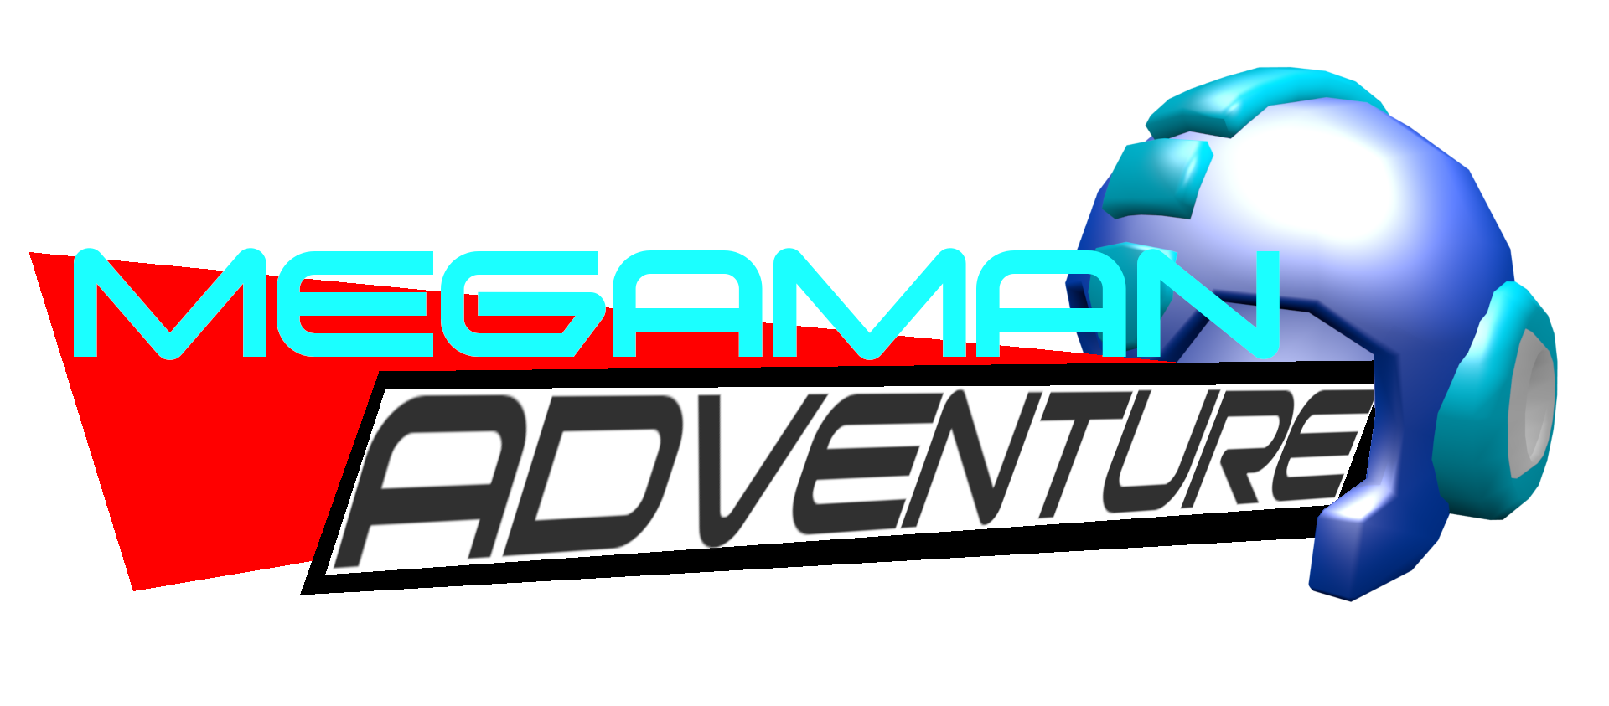
Alpha Build Post-Mortum
Analysis of the sole developer, Zack Kirchens (ZackXevious)

Slide 2
Table of contents
Overview
What I set out to do
Gamedev timer
Game/Work balance
What I actually accomplished.
Response to release
Taking criticism
Going forward.

Slide 3
Overview (about myself)
My name is Zachary Kirchens, I’m a 22 y/o game developer and student from Texas
First game I ever made was in middle school
Simple things in the BGE in Blender 2.49
Last game (before this one) was in high-school
Similar platformer in the BGE in Blender 2.74
Never did serious work in Unity before this game.

Slide 4
Overview (what even is this game?)
MegaMan Adventure is a fangame created by myself for the Sonic Amateur Games Expo 2018
It was designed a created as my first game in Unity
Before this, I made games in Blender
It was a one man effort.

Slide 5
What I set out to do
3D action adventure game with both keyboard, mouse, and controller support in the Unity game engine
Fully explorable
3D camera similar to Super Mario 64
Analog controls, moves with player.
Gameplay feel similar to Ratchet and Clank
Gunplay, multiple enemies, health pickups, etc.
At least 3 stages
A boss fight (with characterization)
Polish enough that people want to play it.
Story?
(This was the bare minimum)

Slide 6
Biting off more than I can chew?
Went chasing after other ideas during development
2D sections
Level themes
Enemy themes
Trying to get people on-board
All while still learning Unity.

Slide 7
Gamedev Timer
Total development time: 3 months (end of May to the end of August)
Game was originally something else for two months, had to be retrofit to be Megaman.
Decent development time?

Slide 8
Game/Work Balance
I don’t make money off my games yet.
This was the busiest time of the year at my work
School stuff
Family stuff

Slide 9
What I actually accomplished.
Movement works, -ish
Camera was fully functional
Boss fight does exist
Multiple enemy types with differing levels of health
Pickups
3 stages, with a fourth one being a boss fight
Island
Island (night)
Evil Base
Evil Base (arena)

Slide 10
What I didn’t accomplish
Multiple boss fights
Ratchet and Clank feel of game
Polish

Slide 11
Why
Didn’t know what I was doing at the time
Ran out of time due to work/school/game-development balance
Had to make-do with what I had at the last second.

Slide 12
Response to release
Game was released in time for the showcase.
Although they played an older version on the Stream.
Views: 2753 atm, with two 5 star reviews
SomeCallMeJohnny gave the game a go as well.
Last game in day 2 of his playthrough.

Slide 13
Response to release pt 2
On SAGE:
Favorable, but not perfect
Overshadowed by games like GrandDadMania and other, more together games
Johnny:
“Thankfully we ran out of time.”
“This is what Megaman was doing on his hiatus”
“Is this robot hell?”

Slide 14
Taking criticism
There is a lot to fix in this game
Features that are a MUST:
Audio control
Sensitivity control

Slide 15
Going forward
I have to move forward.
Longer development times
More emphasis on polished experience vs features
Help others out.

